Slide 1
Four OS Functions

Slide 2
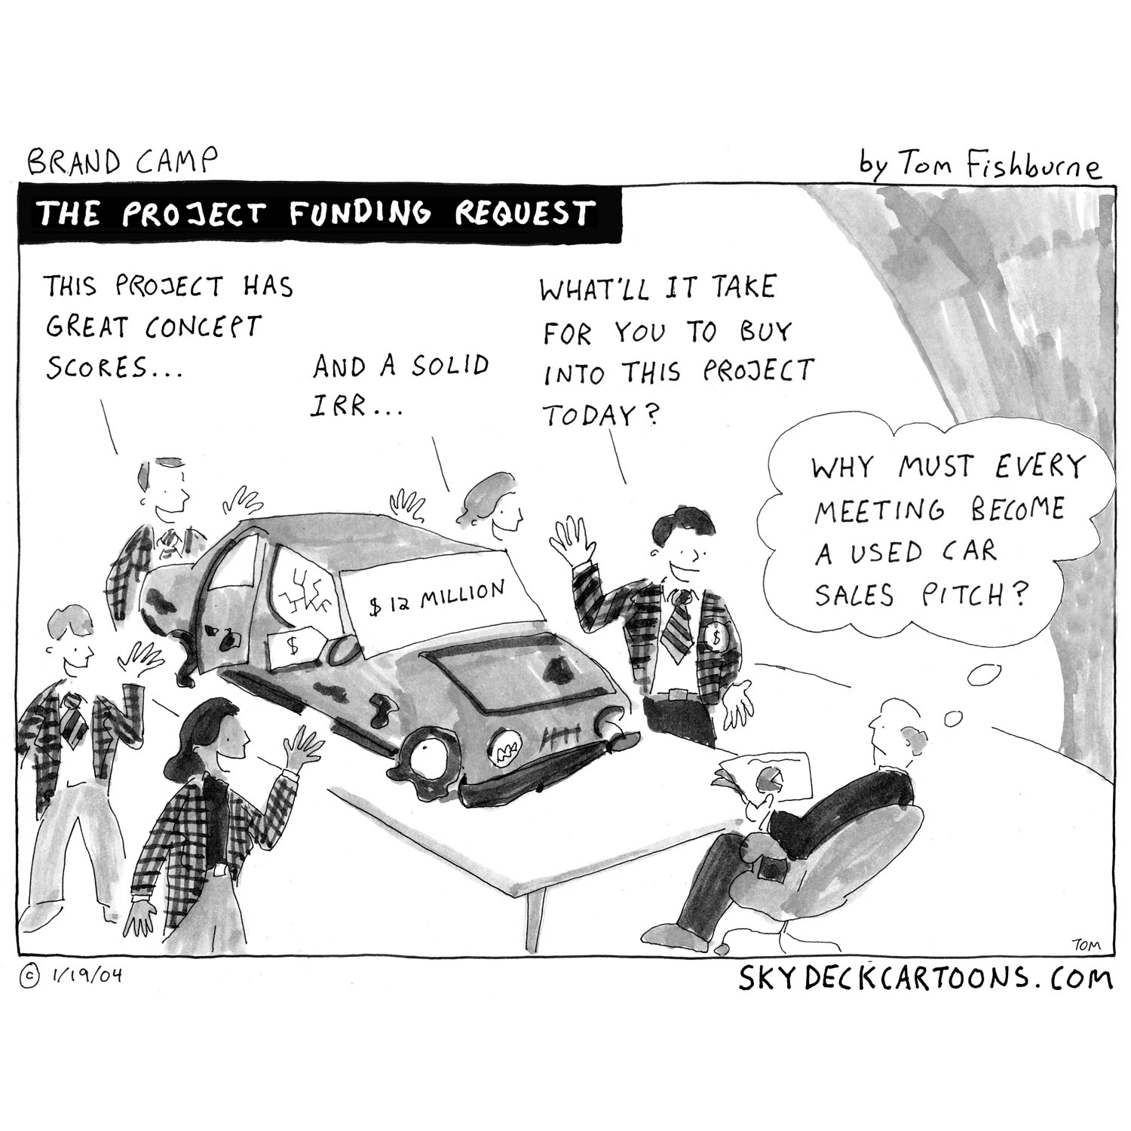
Functions of Operating System (Recap)
Operating system performs many functions. Basically, operating system performs:-
File Management
Process Management
Memory Management
Device Management
Users
Operating
System
User Interface
File
Management
Process
Management
Memory
Management
Device
Management
Hardware
Storage
Devices
CPU
Main
Memory
I/O
Devices
Notes:
I/O – Input/Output

Slide 3
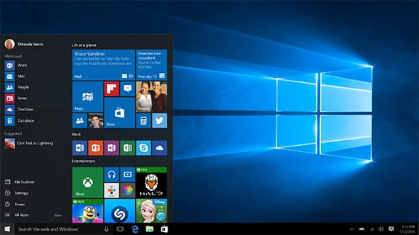
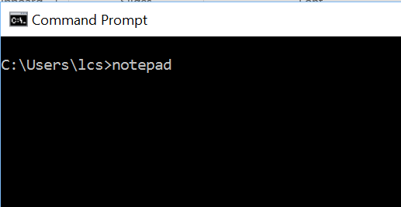
User Interface
Most visible part of an operating system.
It provides:
A visible interface for the user to interact with the computer (graphics user interface and command line interface)
A means for the user to instruct the computer to perform a task

Slide 4
Functions of Operating System
Functions | Description
File Management | Takes care of file-related activities such as organization storage, retrieval, naming, sharing, and protection of files.
Process Management | Takes care of creation and deletion of processes, and providing mechanisms for synchronization and communication among processes.
Memory Management | Takes care of allocation and de-allocation of memory space to programs.
Device Management | Manage I/O devices (e.g. printers, monitors, keyboards, mouse, etc).

Slide 5
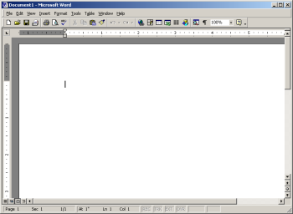
Functions of Operating System
What are the steps involved when a user invokes an application such as the Microsoft Word program to run on a computer?
User gives command to
computer to run the
MS Word program
Computer loads the
MS Word editor
onto monitor screen
Hidden steps:
Computer searches for MS Word
program on disk
Computer loads the program into memory
Loaded program is scheduled to be executed

Slide 6
Tutorial Question 2.1
Below are the steps involved when a user invokes an application such as the Microsoft Word program to run on a computer.
Complete the table on which OS manager and the hardware involved. Discuss with the class. Your lecturer will moderate the class discussion. No submission needed.
Steps invoked | OS Manager | Hardware Invoked
User gives command to computer to run the MS Word program
Computer searches for MS Word program on disk
Computer loads the program into memory
Loaded program is scheduled to be executed
Computer loads the MS Word editor onto the screen

